Slide 1
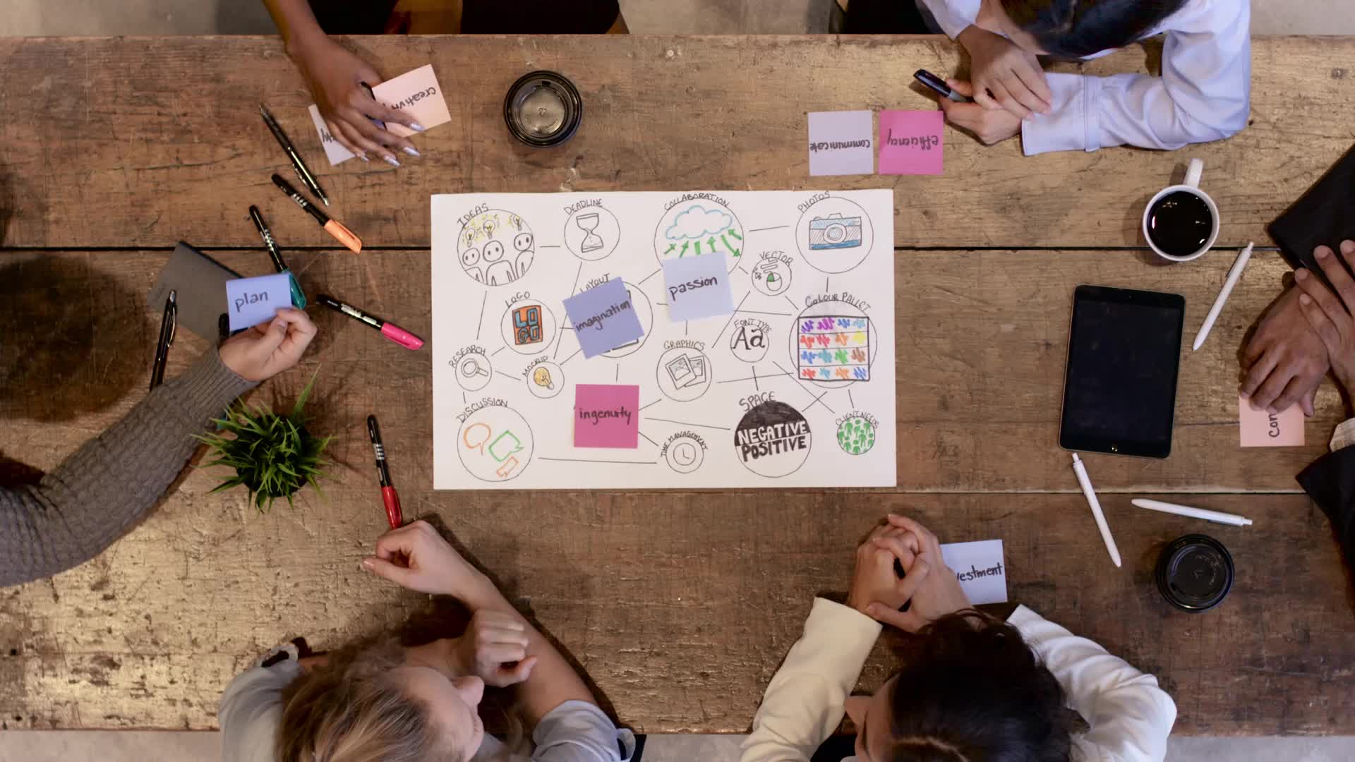
DCI Assignment Group Presentation
Kapil Pokhrel
Bikash Baral
Shivam Ranabhat

Slide 2

Table of contents
Introduction
Technical Goals
Site Location
IT Space
Data Center Tiering Standards
IT Hardware
Energy Management system and Green Computing
Conclusion

Slide 3
Introduction
SPIC MALYASIA is a Malaysian data center consulting company that provides installation and technical services to different companies in order to build a proper data center.
Spic company is to build a data center for the hospital and we as the employ of the data center consulting company are assigned to build and implement a new data center that can help offers reliable services to its clients and patients.
we are to provide a proper infrastructure design for the data center considering on several aspects such as performance,scalability and flexibility. Such designing requires a proper planning, considerations and justifications to achieve the defined requirements.

Slide 4
Data center Requirements
Security
Data centers must be protected against physical threats to its components.
The proposed data center will have multiple security systems.
Cards and biometric systems will be used in order to enter and exit the building.
Scalability
The data center which will be proposed must be able to support the scalability
Proper infrastructure should be recommended which help to scale in future

Slide 5
Reliability
Data center should run 24/7 smoothly
Use power supplies in stand in case of commercial electricity fails
System must be configured so it should not be vulnerable to any threats
Network Performance
lacking a proper infrastructure may have a problem on its network performance
Choosing good equipment to make the network secure and reliable
Data center Requirements

Slide 6
Manageability
Maintenance should be easier.
Location and security should be considered affect the manageability
Data center infrastructure management(DCIM) tools should be used
Manage the data in the data center
Improve efficiency, uptime and productivity
Flexibility
Should be able to moved or replaced according to the needs in future.
Eliminate the use of inflexible infrastructure which increase the expense.
Data center Requirements

Slide 7
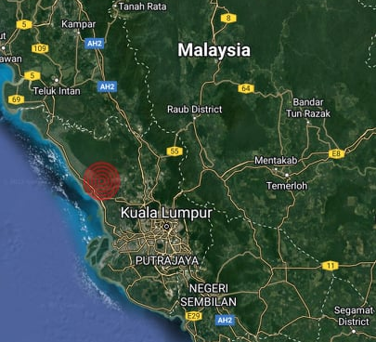
Site Location

Slide 8
IT Space
Main Distribution Area (MDA)
Horizontal Distribution Areas (HDAs)
Zone Distribution Area (ZDA)
Equipment Distribution Area (EDA)
Entrance room

Slide 9
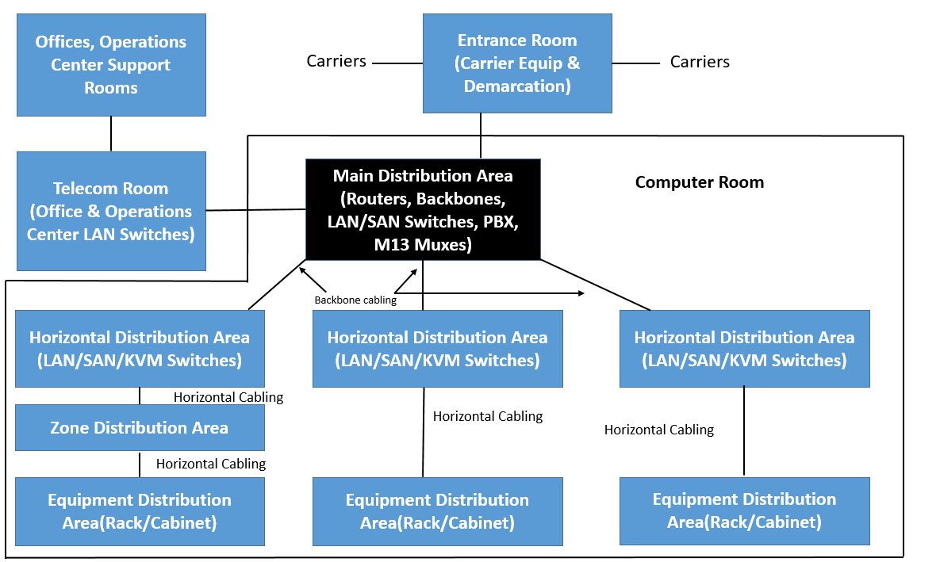

Slide 10
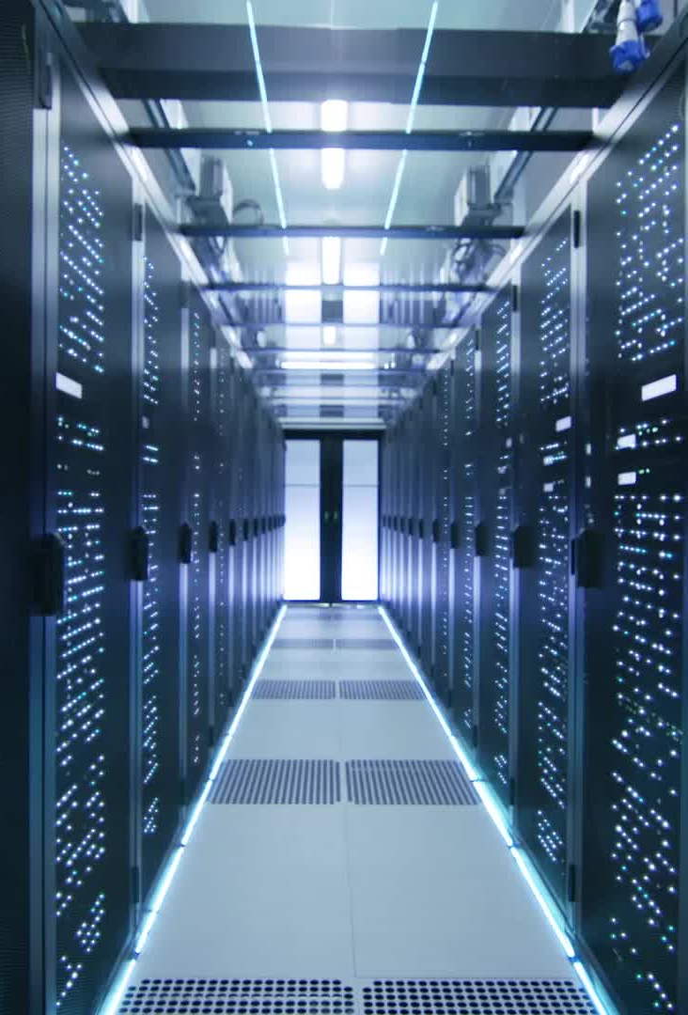
Entrance Room
Interface between the data center structured cabling system and inter-building cabling
May be placed near the computer room considering the security
A data center may have multiple entrance rooms
Help in cable management and provides an additional redundancy

Slide 11
Main distribution Area
Includes the center point of the distribution for the structured cabling system
It includes the main cross connect(MC) and may include horizontal cross connect(HC)
Every data center has at least one main distribution area.
Computer room holds the core routers, core LAN switch
So, MDA will contain the computer room as main cross connect structure cabling.

Slide 12
Horizontal Distribution Area
Space inside the data center where the horizontal cross connect(HC) resides.
Transition point between horizontal and backbone cabling
Includes LAN switches, SAN switches, and Keyboard/Video/Mouse (KVM) switches
The HDA is typically located inside the computer room
Our proposed data center will have a HDA too keeping the scalability into consideration

Slide 13
Data Center Tiering Standards
A data center tier standard has four ranks where one is the worst and 4 being the best performing level.
A data center receives its international ranking from Uptime institute,
Uptime institute determines the tier of the data center based on the uptime, fault tolerance and service cost of the data center.
The higher the tier is, the higher the availability.

Slide 14
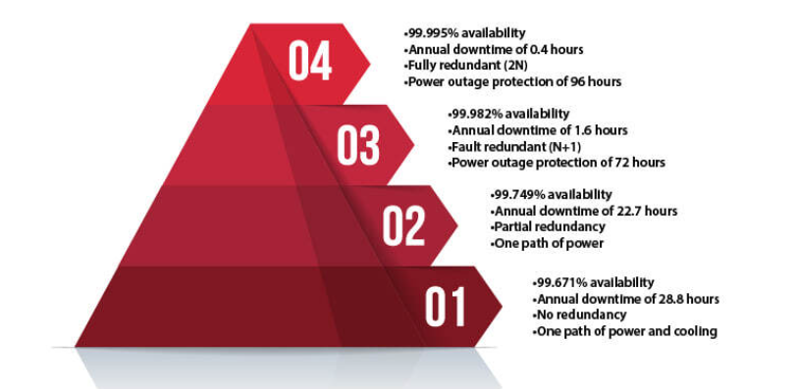

Slide 15
Recommendation
Tier 3 certification for our proposed data center for Columbia hospitals.
Concurrently maintainable
Qualified to achieve the needed uptime with lower cost and faster implementation time.
As our proposed data center is in Malaysia the country has only one known power source utility called Tenaga Nasional Berthed(TNB).
Tier 3 is qualified and recommended for Columbia hospitals data center only one source and the TNB fulfills the gap

Slide 16
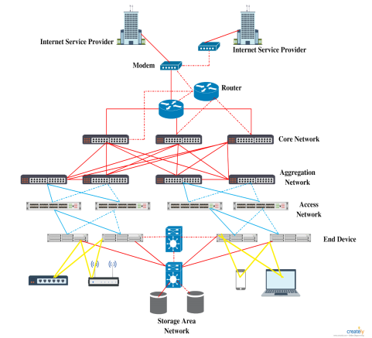
Tier 3 architecture

Slide 17
IT Hardwares
Cabling
Structured cabling is chosen over unstructured cabling.
Structured cabling includes horizontal and backbone cabling
Core layer provides the interconnection with in the data center
Aggregation layer provides high-bandwidth export
Access layer supports high-density access

Slide 18
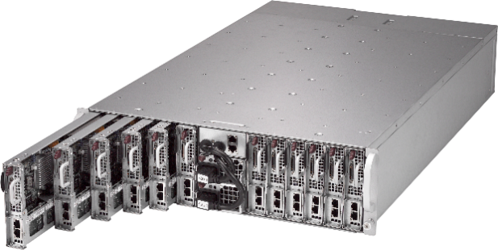
Server
Chosen Server: Blade Server
Fast processing speed which supports a large quantity of data
Lower the energy usage
Supports green computing

Slide 19
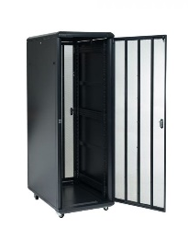
Server Racks
Chosen Server Racks: Server Rack Cabinet
Most affordable closed rack
42 U racks and has enough room for gear
Individual cabinets can be opened without
affecting other cabinets during maintenance
Reasonable price

Slide 20
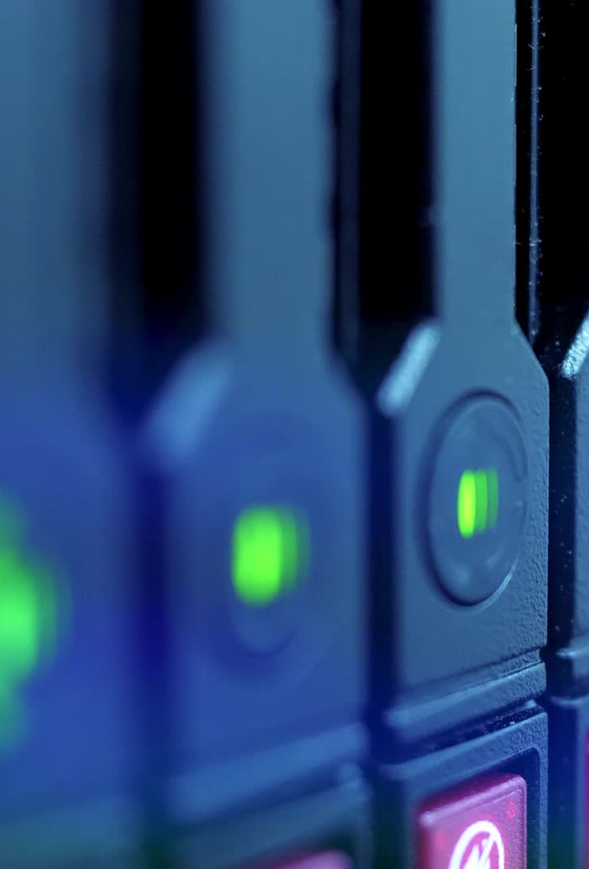
Networking Devices(Router and Switch)
Recommended Router
Router from cisco catalyst 8500 series edge platform for our proposed data center.
Model number of C8500L-8s4X is chosen due to
High performance
Cloud edge platform designed for accelerated service.
Provides a multi layer security, cloud-native agility, and edge intelligence

Slide 21
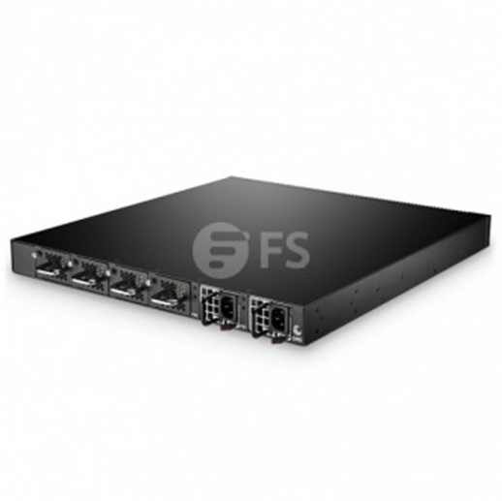
Recommended Switch
Fiber optic switch from fiber store.com, popular communications equipment company in the world.
Easily available than other switches in context of Malaysia
Low price and good customer service.
The switch model S5850-48S6Q is recommended due to its performance, availability and ease of management.

Slide 22
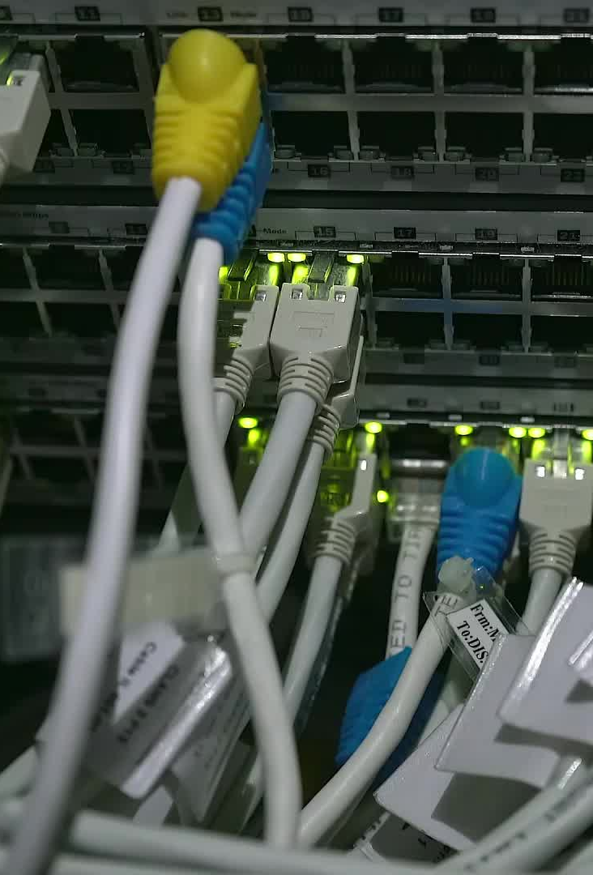
Storages
Direct Attached Storage (DAS)
Network-Attached Storage NAS
Storage Area Network (SAN)

Slide 23
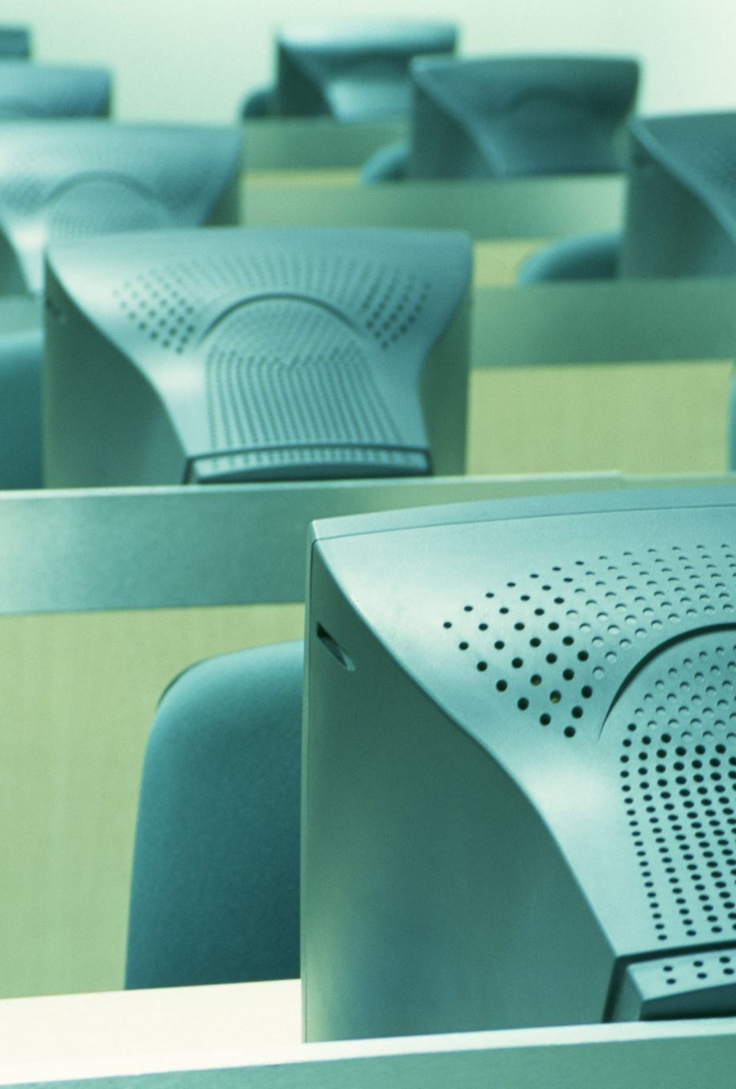
Recommendation for Columbian Hospital
This is a good fit for Columbia Hospital needs, as they run a range of applications such as Customer Relationship Management (CRM) and Electronic Health Records (EHR).
SAN has its own recovery strategy, with backup SANs that may span a substantial distance while still working on the same network..
As SAN implements Fiber Channel (FC) standards, it can deliver high-speed, continuous data transfers of massive volumes of data (up to 16 Gbps), resulting in great data availability and storage performance

Slide 24
Security
Physical Security
Various forms of built-in safety standards must be used to safeguard the data center physically and ecologically. Security guards will be on duty 24 hours a day, seven days a week, and closed-circuit television (CCTV) cameras will be installed to monitor the Data Center.
Only authorized staff will be able to access the server room, which will be secured with a card key lock or fingerprint door lock.
A fire detection and smoke detection system, as well as a suppression system, will be installed throughout the structure. Because information can be harmed by water, the server room will only have a fire alarm.
Logical Safety
we've introduced logical security mechanisms including two-factor authentication and updating user access lists to protect sensitive data
To safeguard the core network servers, we've incorporated multi-level intrusion prevention (IPS/IDS).
To prevent our IP from being stolen or abused, we utilize firewalls, anti-virus, anti-spam, and anti-malware software. All common service ports are also protected by SSL encryption.

Slide 25
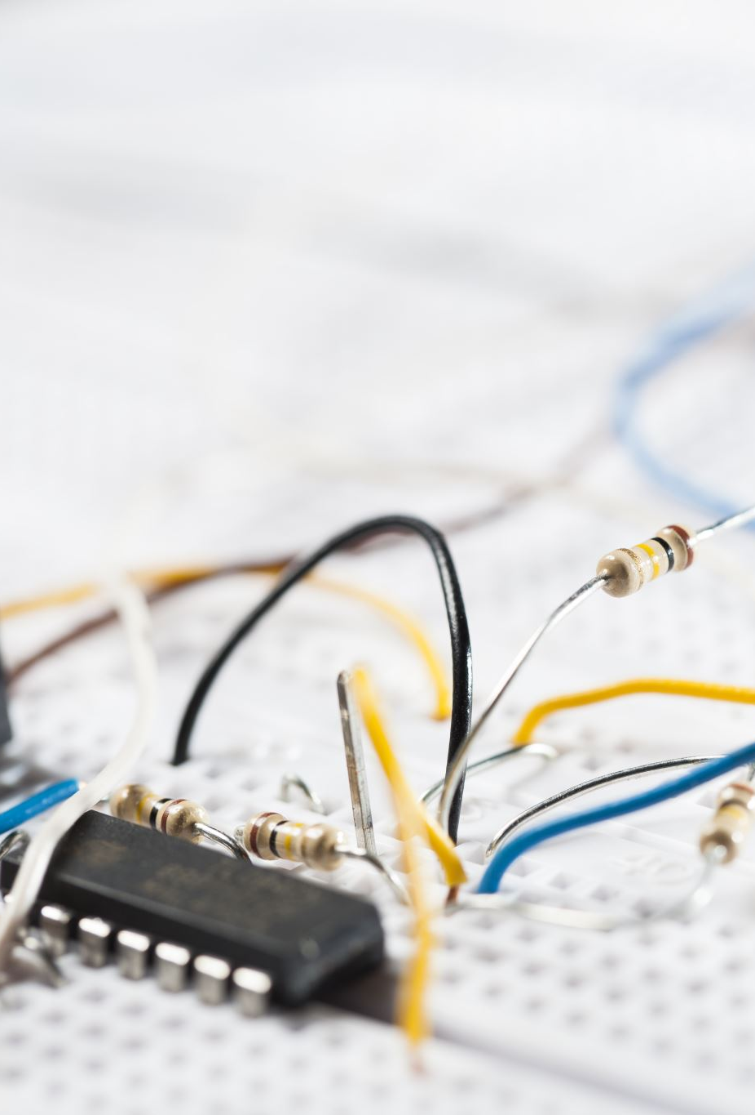
Power
Uninterruptible Power Supply (UPS)
This is a backup system that is used to assure that various electrical gadgets receive uninterrupted power.
The primary goal of a UPS is to provide backup power in the case of a power outage, hence preventing transmission errors and data loss.
It will deliver electricity to the Power Distribution Unit of the Columbia Data Center (PDU).
Power Distribution Unit (PDU)
The power distribution unit (PDU) is a sort of electrical and power distribution system that manages to give alternating current (AC) power to various I.T equipment items, such as computers, servers, and networking devices, that are located within a rack system
A modular PDU was chosen since it is far more convenient than a standard data center.

Slide 26
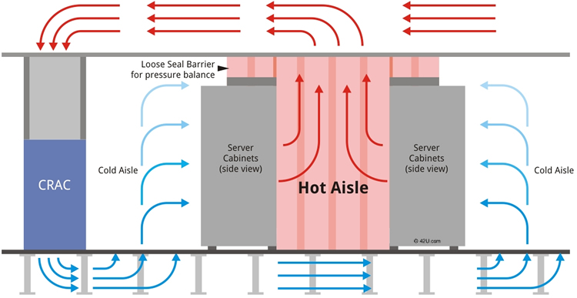
Cooling System
Chosen cooling system: Hot aisle Containment System
Chosen by all the data center for cooling system
Hot aisle minimize heat by blocking it
Supports green computing
Less expensive

Slide 27
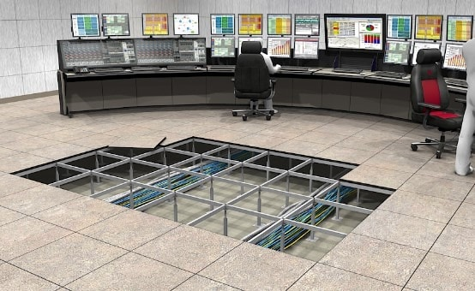
Space Requirement
Chosen method: Raised floor
reduces the size of the room &
overall size of the data center
Area needed to be cooled become
smaller by adopting raised floor
enables the cable management
options
Maintenance or repairing of cabling will be easier

Slide 28
Energy Management System and Green Computing
Servers, storage, and data centers should be consolidated
Using blade server which is consolidated into single chassis
Use same power supply, fans, network, and storage device
Minimize the usages of power supply
Perform a Baseline Energy Audit
Find Air Leaks
Inspect HVAC every 12 weeks
Look at lightning (i.e., replace the use of fluorescent lighting with LEDs)

Slide 29
Turn off any unused IT devices
Using power management software
Replacing the old servers with newer versions
Choose Eco-friendly materials and environmental features
low emission materials, waste recycling, usage of alternative energy
Updating air compressors, paper shredding, and
Use locally sourced renewable resources for power servers

Slide 30
Conclusion
We created a data center for a health-care organization, in accordance with the assignment rules.
We've suggested a Data Center Design strategy that includes all of the required components and criteria
We were able to meet the necessary issues related to data center design by combining new technologies such as blade servers, which require significantly more power and cooling capacity, demands to consolidate multiple data centers into fewer locations, improvements in operating procedures

Slide 31
References
https://www.techbuyer.com/uk/blog/what-is-a-tower-server#:~:text=Tower%20Servers%20are%20affordable%20IT,midsize%20organisations%20across%20the%20globe.&text=Designed%20to%20be%20installed%20in,similar%20in%20size%20and%20shape.
https://www.serverwatch.com/hardware/blade-servers-vs-rack-servers/
https://www.huiyainc.com/non-raised-floor-data-center.html
https://www.facilitiesnet.com/datacenters/contributed/5-Steps-to-a-Green-Data-Center--40635

Slide 32

Thank you

